Slide 1
Android application ( Image Steganography + Slow Loris dos Attack Implementation )
Submitted To:
Ms. Monika Agrawal
Ms. Rupali Dubey
Minor Project
Ayush Nigam (22), Nabhiraj Jain {CSE 6th Semester}

Slide 2
> Introduction
This project includes the implementation of Steganography and Slow Loris-DoS attack in the Android Operating System Environment.
Steganography : the practice of concealing messages or information within other non-secret text or data.

Slide 3
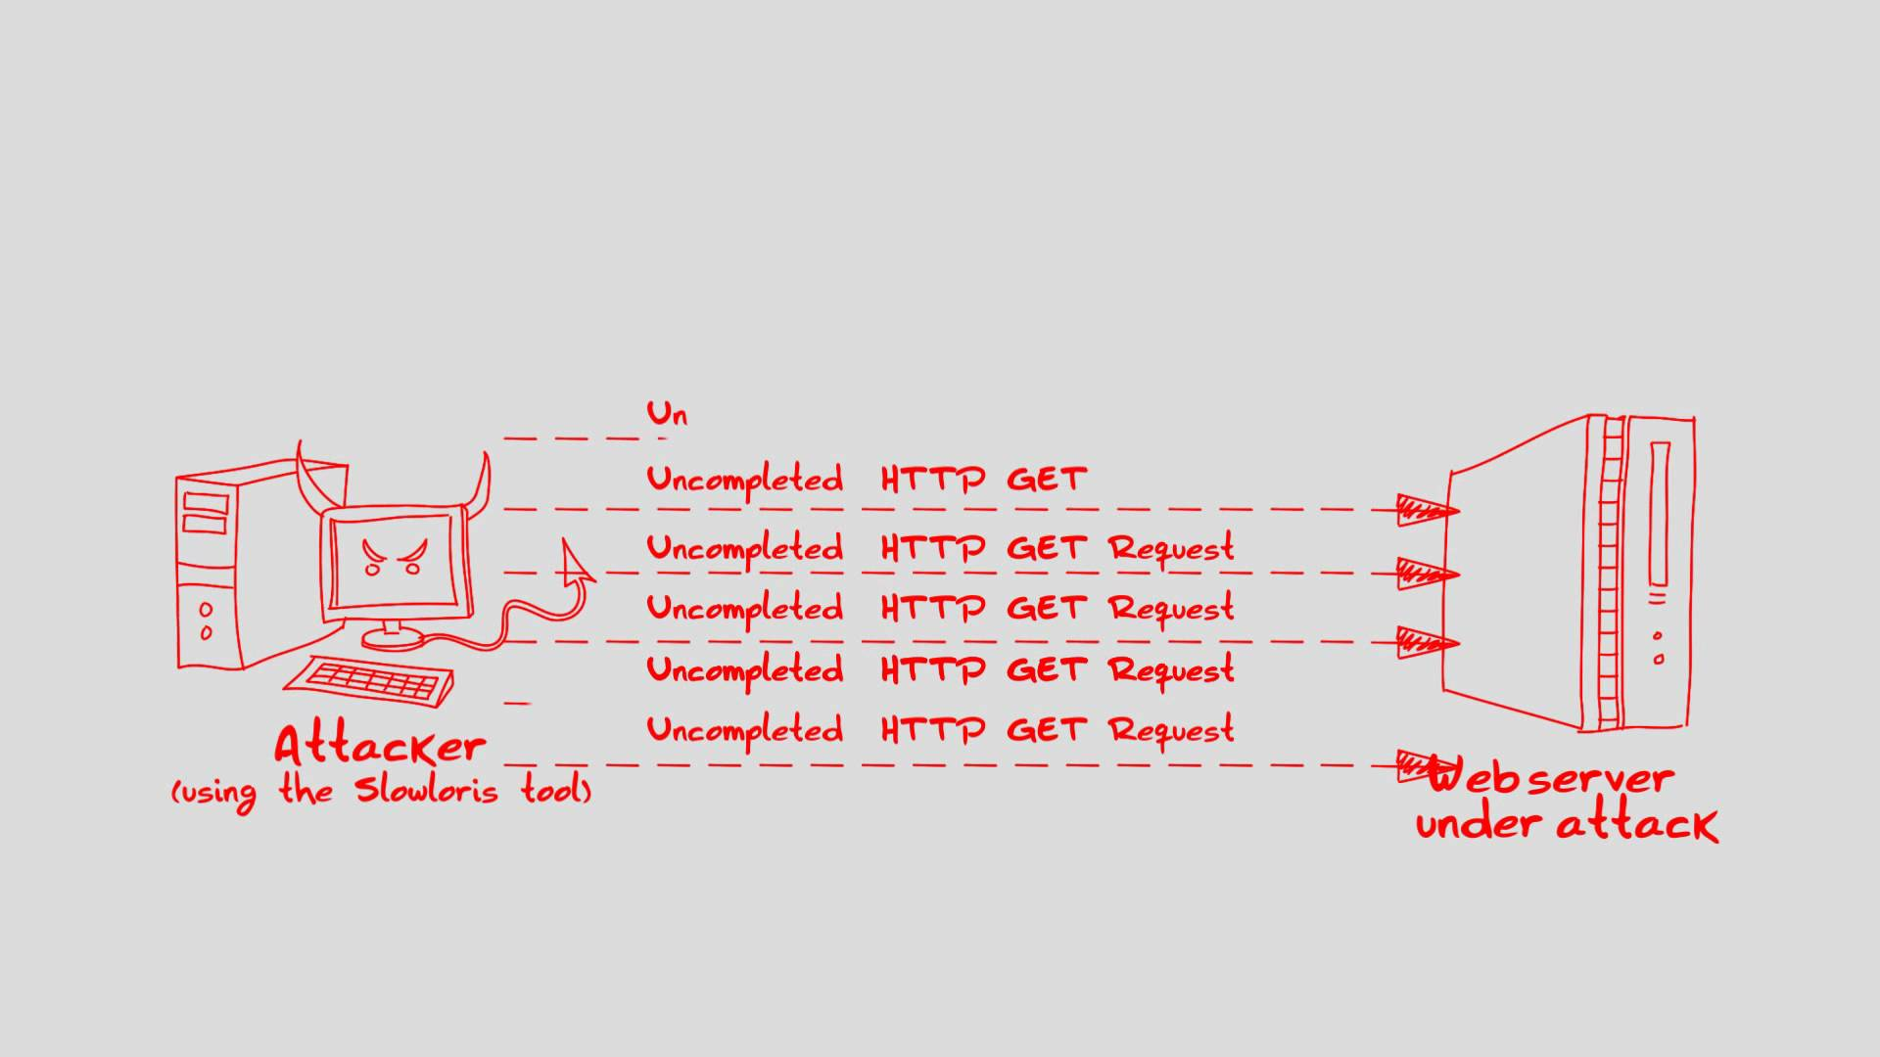
> Slow Loris DoS Attack

Slide 4
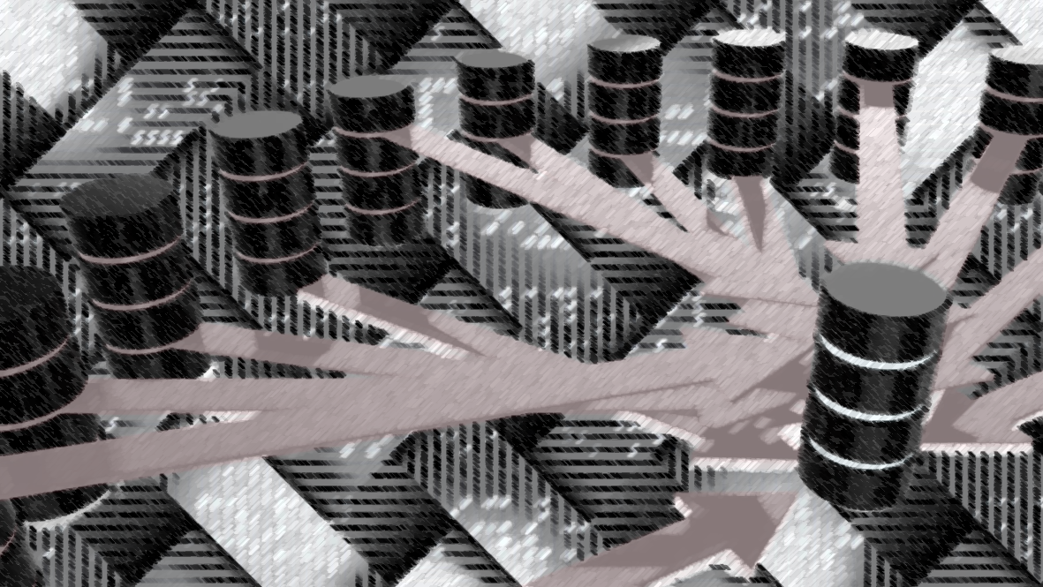
> Objectives
To create an android application that can:
Put digital signature in an image
Crashing the culprit server by Slow Loris-DoS attack if the real owner of the image becomes the victim of piracy

Slide 5

> Benefits
It can be helpful to control the piracy to a great extent

Slide 6
> Scope
Target Audience :
Photographers
Social Media activists
Studio Professionals
Any person dealing with sensitive information through medium of images
Future Scope:
Can be modified with web crawler to fully automate the task
Support of more file extensions will make it a powerful tool to tackle piracy

Slide 7
> Functional Requirements
Application should possess the following functional requirement:
Should accept image as input
Should correctly steganography the image without crashing
Should be able to handle the control of SDoS attack i.e. to start and stop the attack with the consent of the user
Should smoothly switch between the activities

Slide 8
> Non-Functional Requirements
Application should possess the following non-functional requirement:
Execution Qualities
Secure
Easily Usable
Evolution Qualities
Easily Maintainable
Testable
Scalable

Slide 9
Technical Requirements
….Just Next Slide

Slide 10
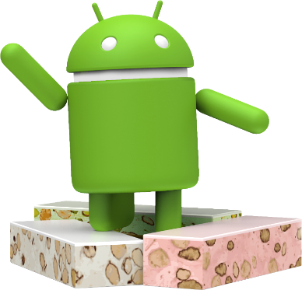
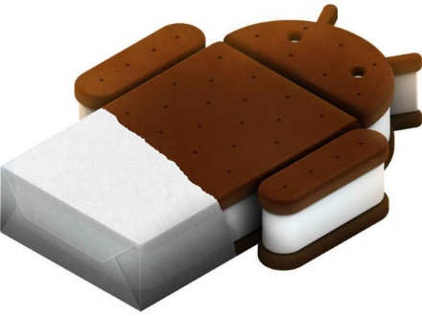
> Software requirements
Requirement:
Android Operating System Version 4 and above

Slide 11
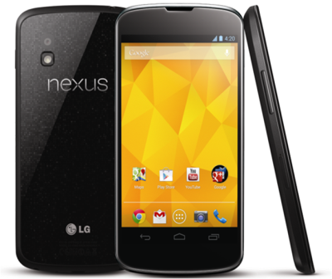
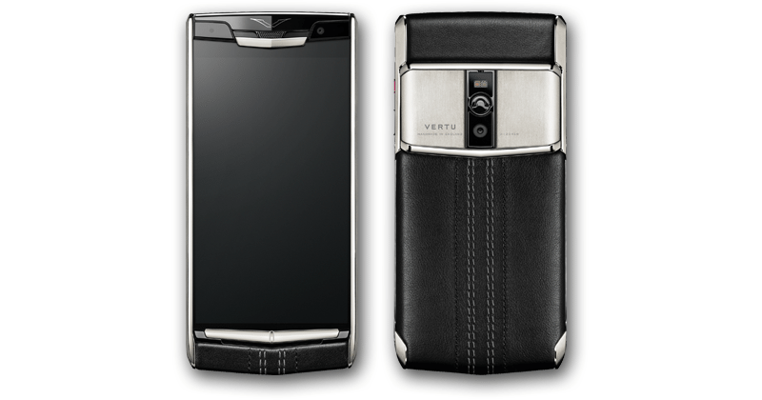
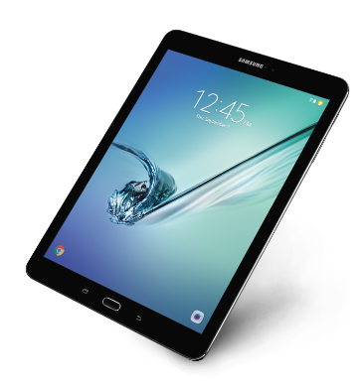
> Hardware Requirements
Requirements:
Android device with:
Minimum of 512 MB Random Access Memory
Data Connectivity Feature of type 2G or above
Multi core processor with minimum base frequency of 0.9 Giga Hertz

Slide 12
PROPOSED MODEL (Waterfall Model)

Slide 13
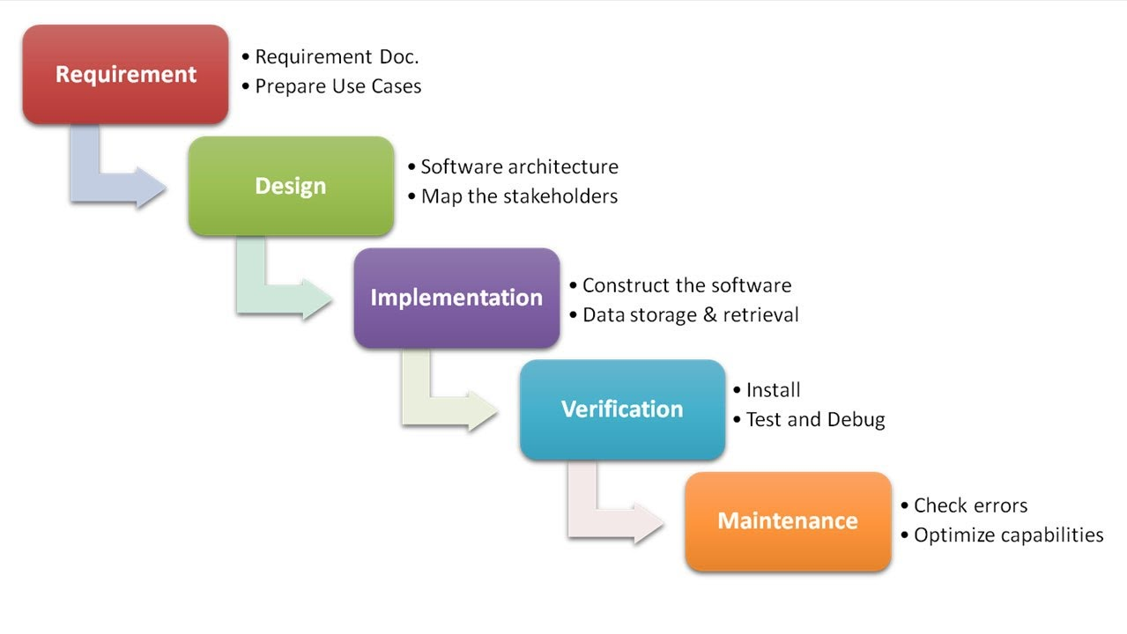

Slide 14
TECHNOLOGY

Slide 15
> Front End
XML :
Extensible Mark-up Language (XML) is a mark-up language that defines a set of rules for encoding documents in a format that is both human-readable and machine-readable

Slide 16
> Back End
Following back end technologies are used
Java
Gradle Scripts
Android Libraries

Slide 17
SOFTWARE AND TOOLS

Slide 18
> Software and Tools
Software and Tools used are as follows:
Android Studio IDE
Android Software Development Kit (SDK)

Slide 19
UML DIAGRAMS
….From Next Slide

Slide 20
CLASS DIAGRAM

Slide 21
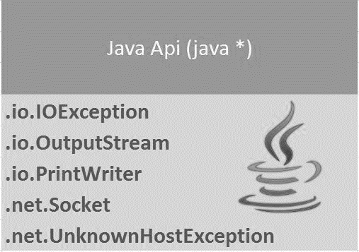
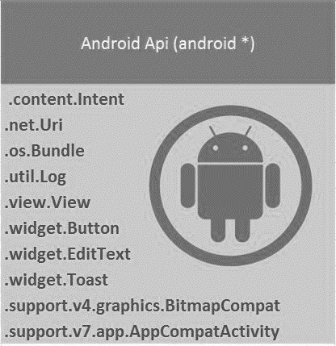
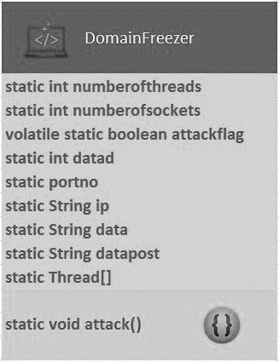
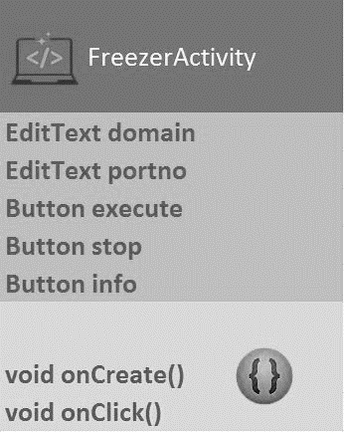
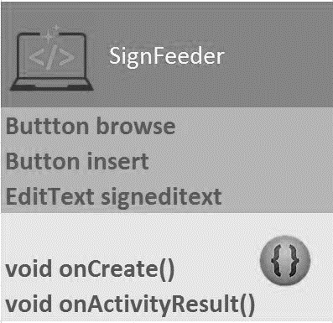
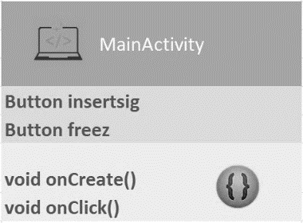

Slide 22
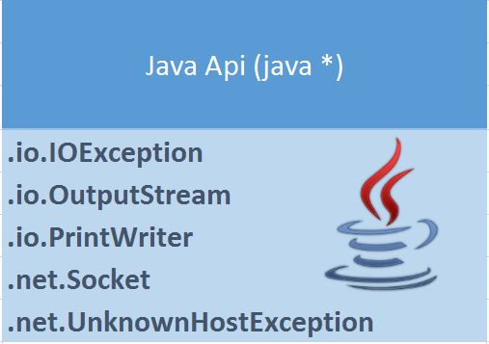

Java APIs

Slide 23
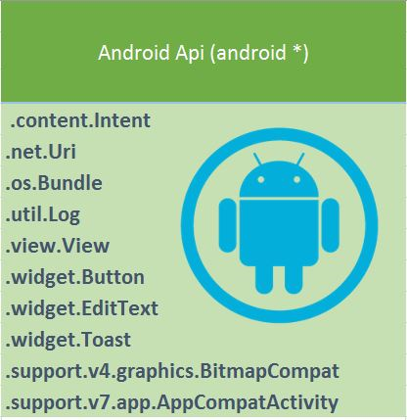
Android APIs

Slide 24
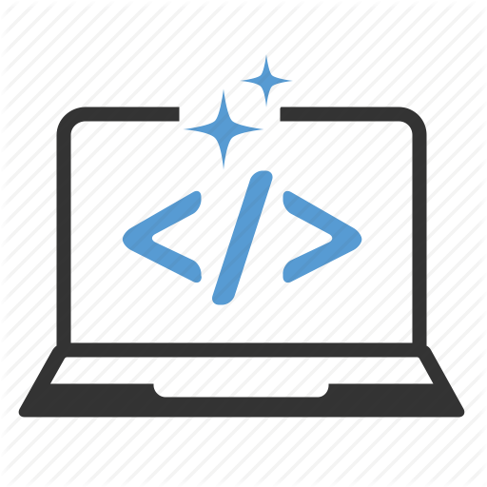
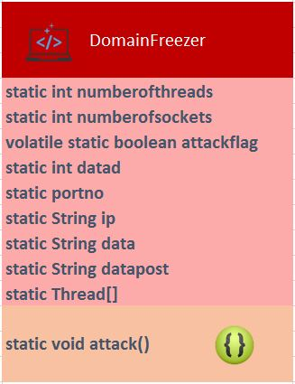
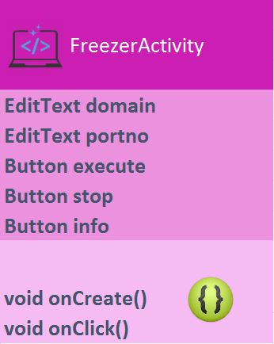
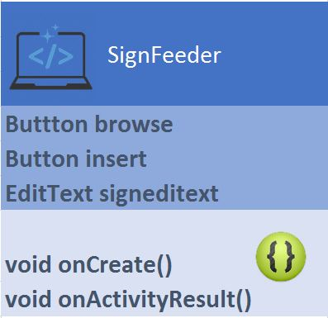
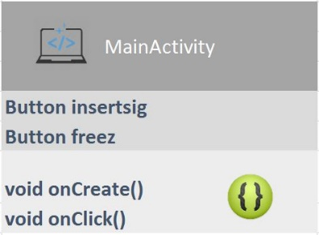
USER Defined Java Classes

Slide 25



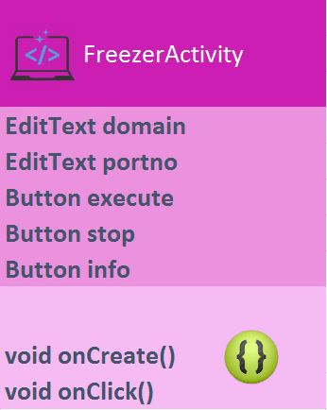



Slide 26
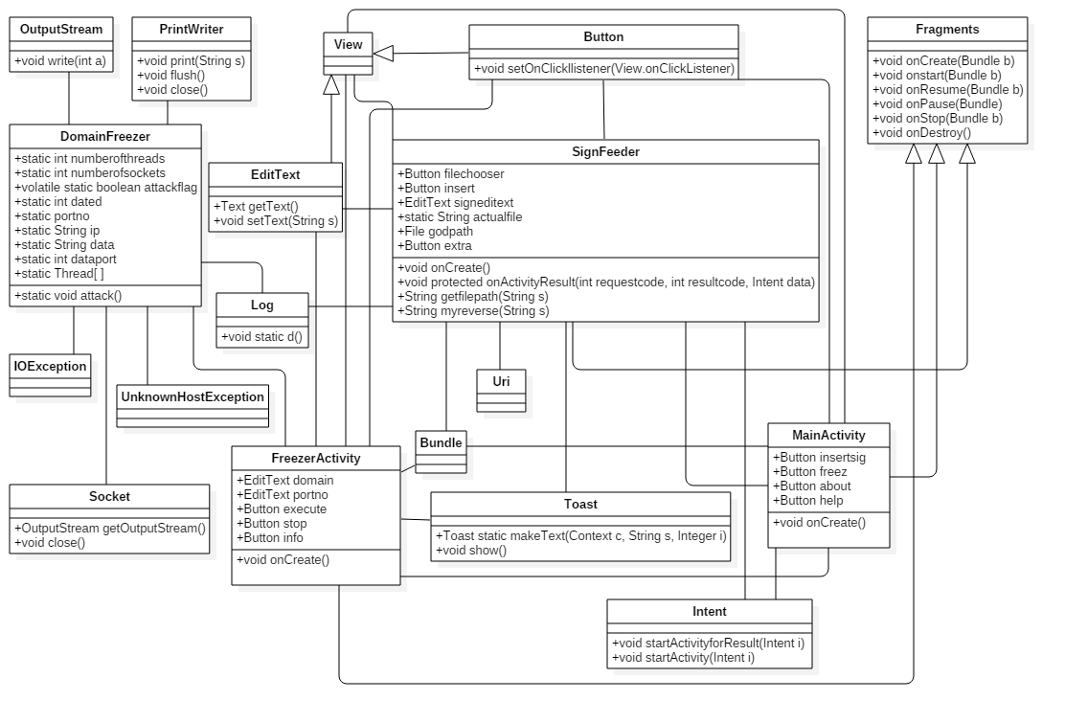
Final Class Dig.

Slide 27
USE CASE DIAGRAM

Slide 28
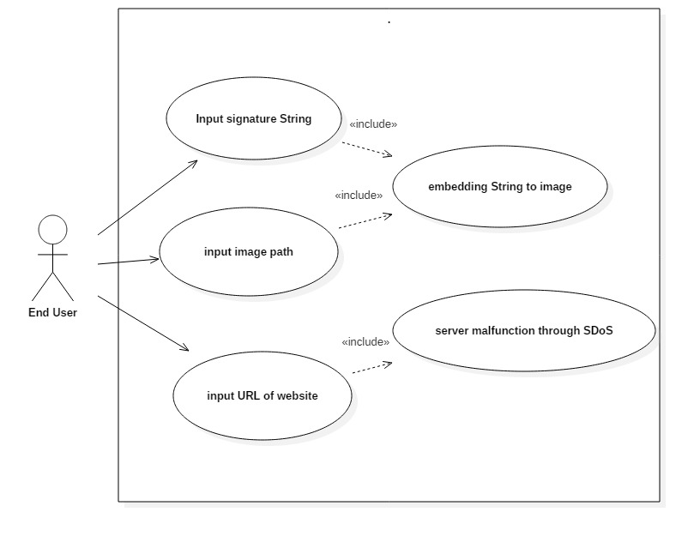
Use Case Diag.

Slide 29
ACTIVITY DIAGRAM

Slide 30
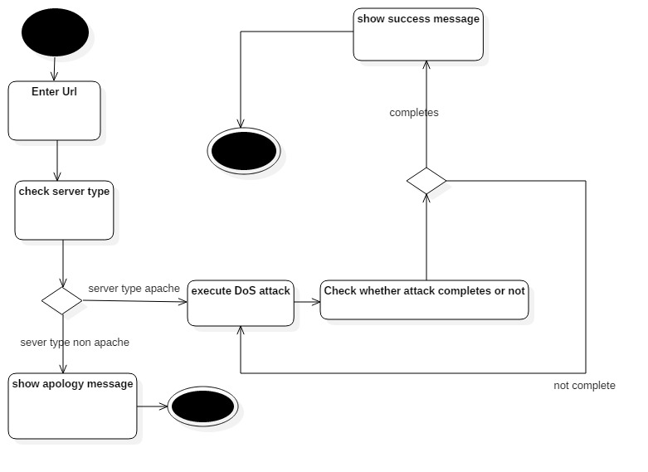
Activity diag. for DoS attack

Slide 31
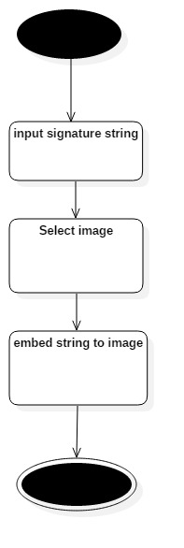
Activity diag. for steganography

Slide 32
SEQUENCE DIAGRAM

Slide 33
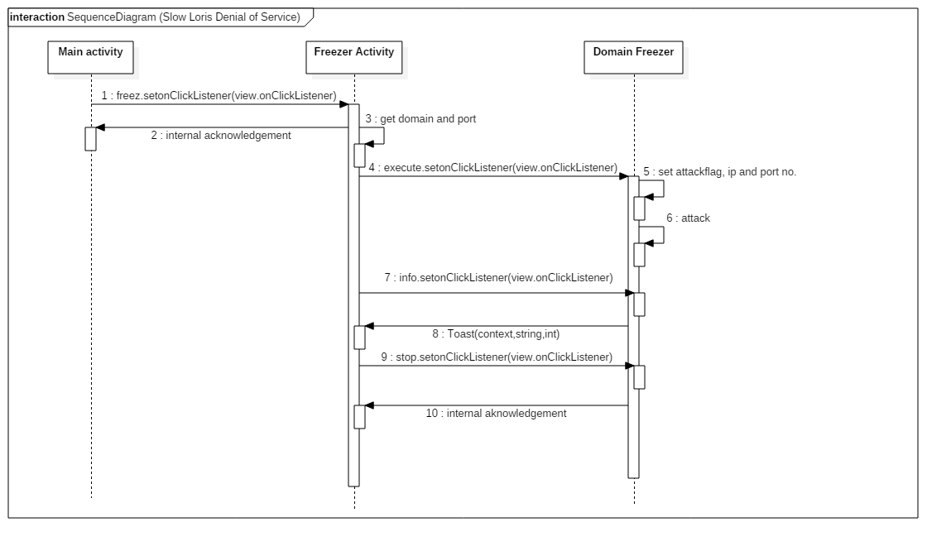

Slide 34
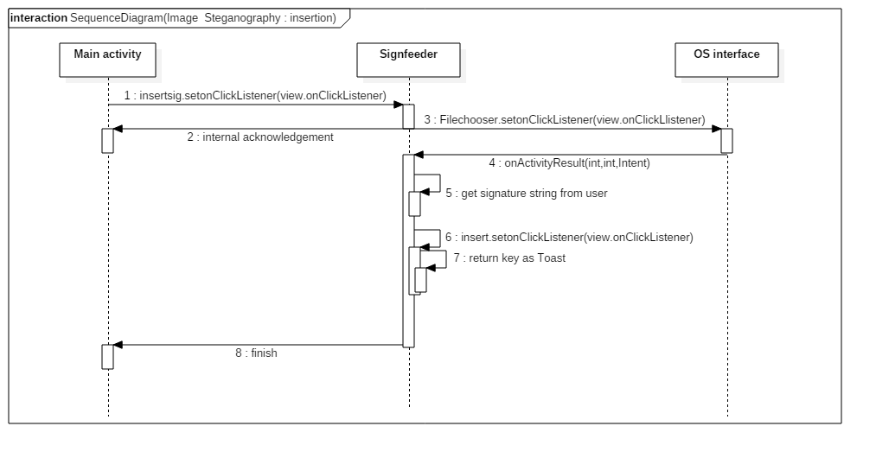

Slide 35
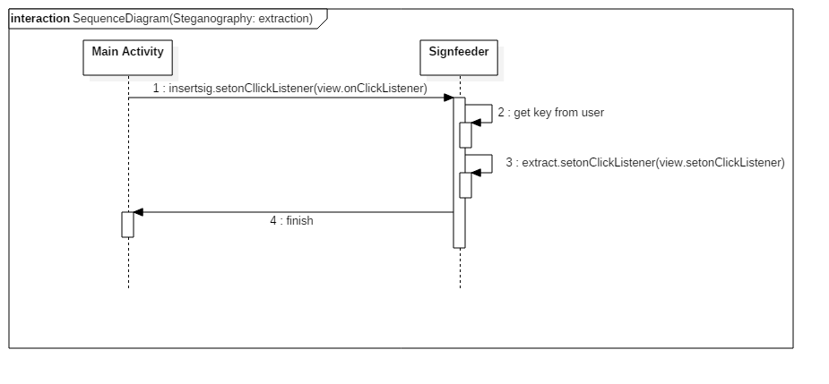

Slide 36
DATA FLOW DIAGRAM

Slide 37
info
MaiṇActivity
intent
intent
Domaifreezer
Signfeeder
intent
Ip, domain, port
Path, action, sign, key
FreezerActivity
User
Ip, domain, port

Slide 38
STATE DIAGRAM

Slide 39
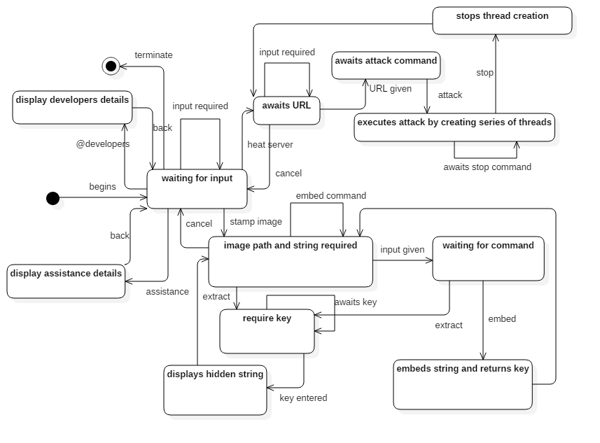
State dig.

Slide 40
ENTITY RELATIONSHIP DIAGRAM

Slide 41
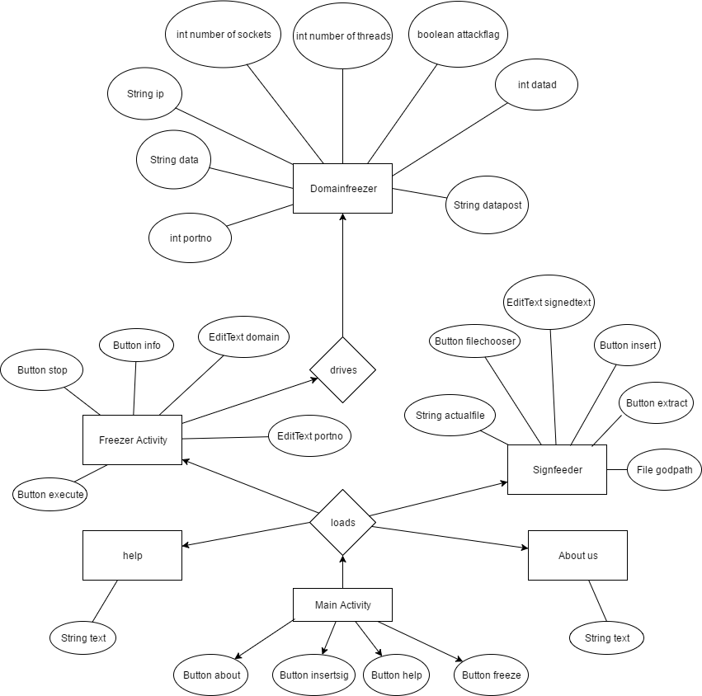
ER dig

Slide 42
COMPONENT DIAGRAM

Slide 43
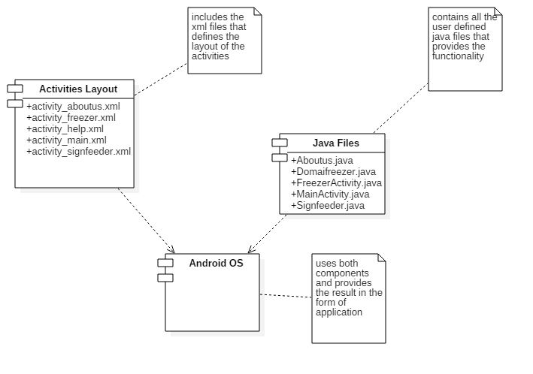
Component dig.

Slide 44
DEPLOYMENT DIAGRAM

Slide 45
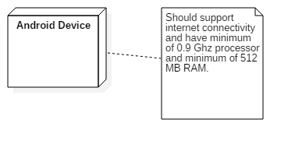
Deployment dig.

Slide 46
Layouts
From Next Slide….

Slide 47
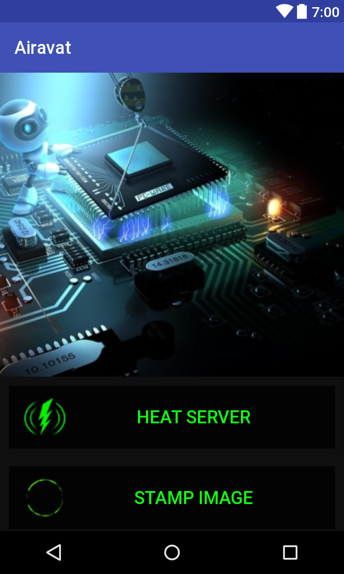
Home Screen

Slide 48
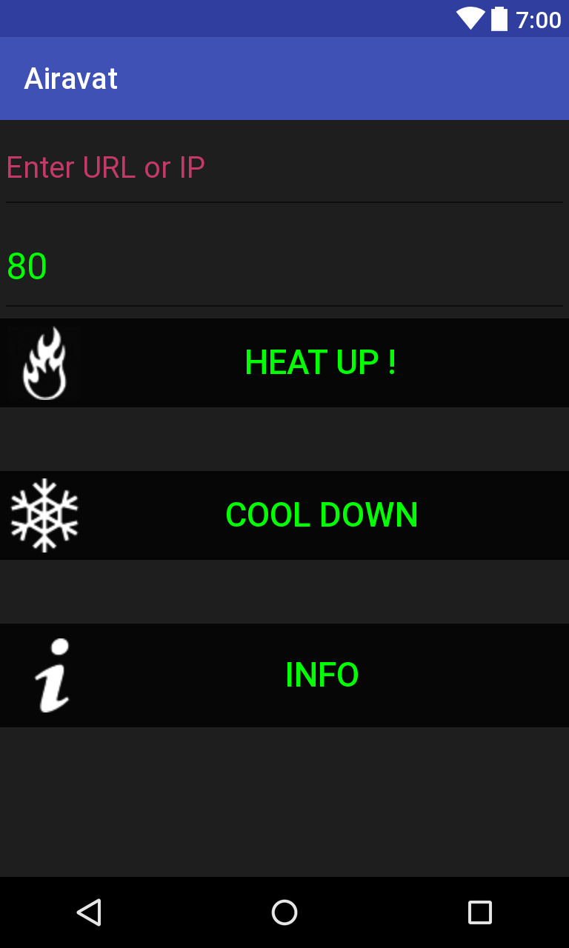

Slide 49
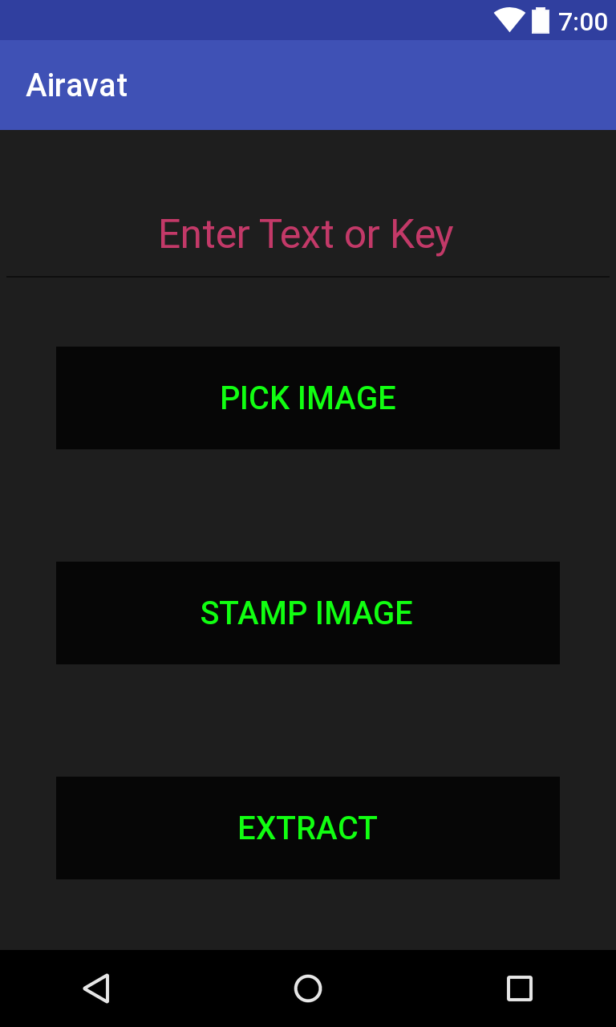

Slide 50
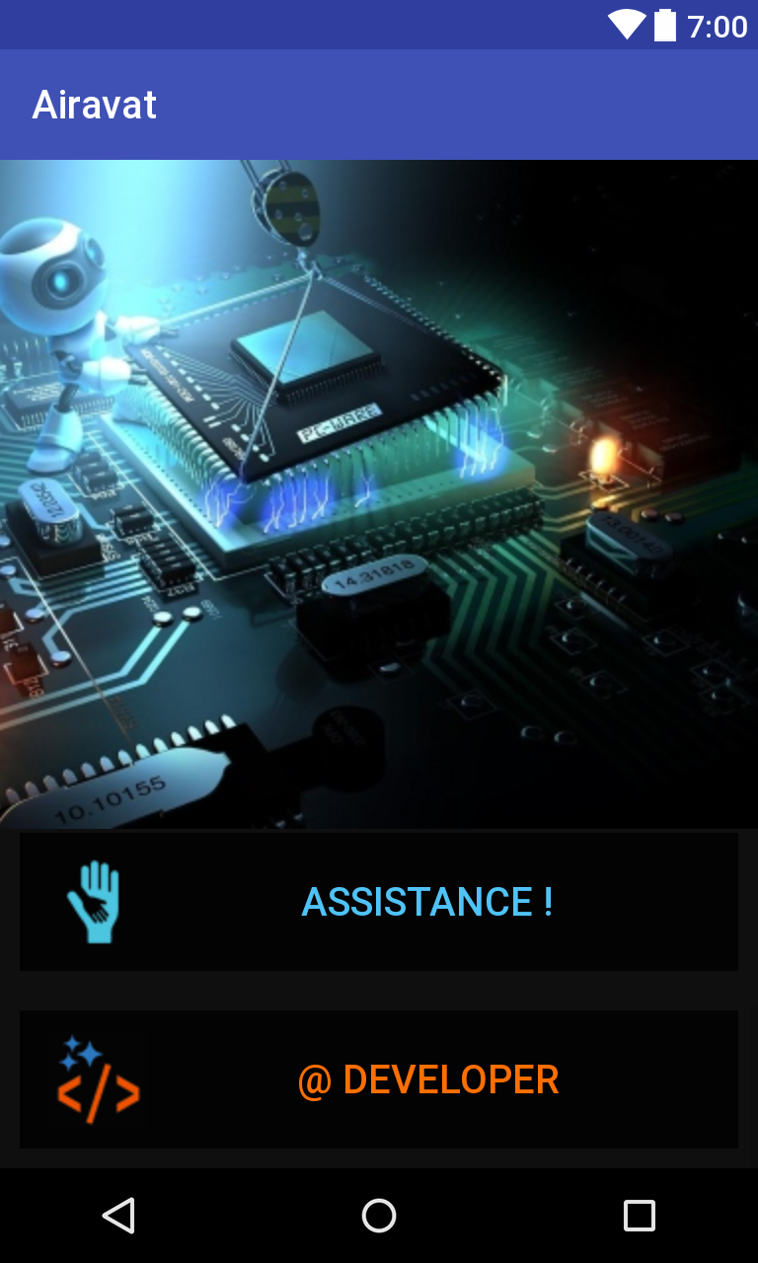
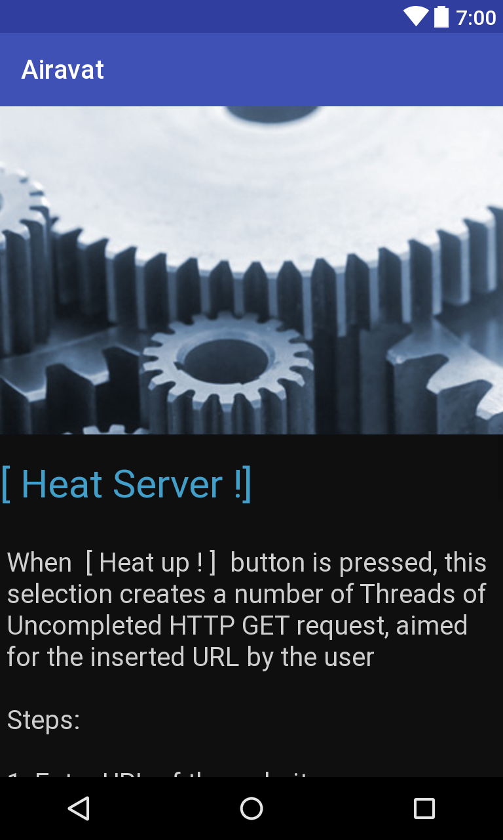

Slide 51
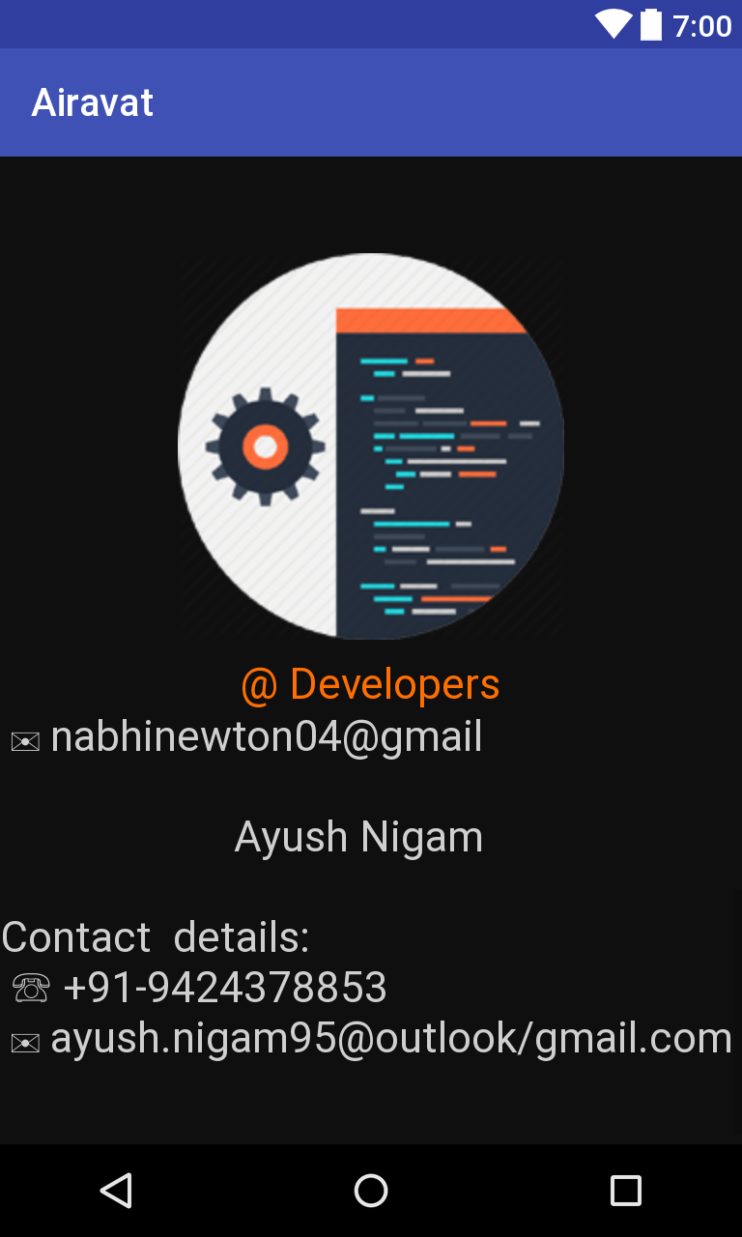

Slide 52
Current Status of work
Completed ! !

Slide 53
Thank You for your Time !

